Slide 1

Lecture 35
DATA 8
Spring 2020
Decisions & Subjective Probabilities

Slide 2
Announcements
Project 3's only checkpoint is due today 4/24, and the entire project is due 5/1.
HW12 is due next Thursday 4/30 (Wednesday 4/29 for a bonus point).
Lab 9, HW10, and Project 2 grades will be released today 4/24, regrades are due Monday 4/27.

Slide 3
Decisions

Slide 4
Decisions Under Uncertainty
Interpretation by Physicians of Clinical Laboratory Results (1978) "We asked 20 house officers, 20 fourth-year medical
students and 20 attending physicians, selected in 67 consecutive hallway encounters at four Harvard Medical School teaching hospitals, the following question:
"If a test to detect a disease whose prevalence is 1/1000 has a false positive rate of 5%, what is the chance that a person found to have a positive result actually has the disease, assuming that you know nothing about the person's symptoms or signs?"

Slide 5
Decisions Under Uncertainty
Interpretation by Physicians of Clinical Laboratory Results (1978) "Eleven of 60 participants, or 18%, gave the correct answer.
These participants included four of 20 fourth-year students, three of 20 residents in internal medicine and four of 20 attending physicians. The most common answer, given by 27, was that [the chance that a person found to have a positive result actually has the disease] was 95%.

Slide 6
Conditional Probability

Slide 7
Scenario 1
Scenario:
Class consists of second years (60%) and third years (40%)
50% of the second years have declared their major
80% of the third years have declared their major
I pick one student at random.
Which is more likely: Second year or Third year?
Second year, because they are 60% of the class

Slide 8
Scenario 2
Slightly different scenario:
Class consists of second years (60%) and third years (40%)
50% of the second years have declared their major
80% of the third years have declared their major
I pick one student at random... That student has declared a major!
(Demo)
Which is more likely: Second Year or Third Year?

Slide 9
Bayes' Rule

Slide 10
Purpose of Bayes’ Rule
Update your prediction based on new information
In a multi-stage experiment, find the chance of an event at an earlier stage, given the result of a later stage

Slide 11
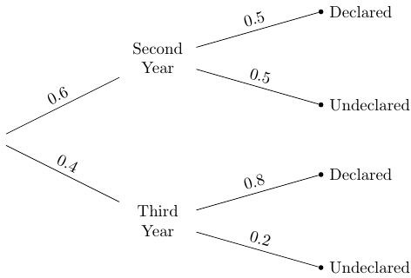
Diagram and Terminology
Prior probability
Likelihood
Likelihood
Prior probability

Slide 12
Data & Calculation
Posterior probability:
P(Third Year | Declared)
0.4 x 0.8
=
(0.6 x 0.5) + (0.4 x 0.8)
= 0.5161…
Pick a student at random.

Slide 13
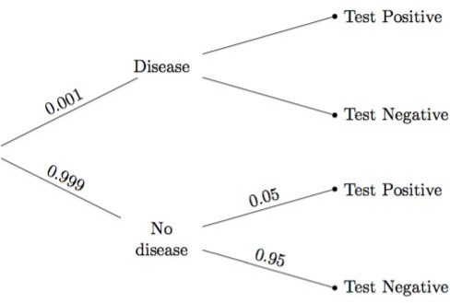
Example: Doctors & Clinical Tests
Problem did not give the
true positive rate.
That’s the chance the test says “positive” if the person has the disease.
It was assumed to be 100%.
?
?

Slide 14
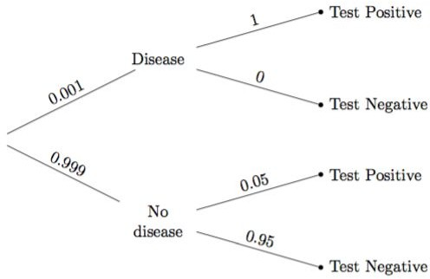
Data and Calculation
P(Disease | Test +)
=
0.001 * 1
(0.001 * 1) + (0.999 * 0.05)
= 0.0196270…
(Demo)

Slide 15
Subjective Probabilities

Slide 16
Subjective Probabilities
A probability of an outcome is…
The frequency with which it will occur in repeated trials, or
The subjective degree of belief that it will (or has) occurred
Why use subjective priors?
In order to quantify a belief that is relevant to a decision
If the subject of your prediction was not selected randomly from the population

Slide 17
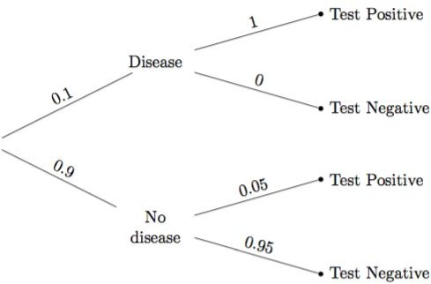
A Subjective Opinion
prior probability that the person has the disease
(Demo)

Slide 18
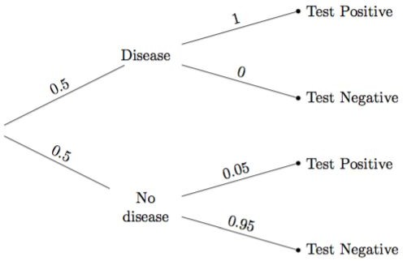
A Different Subjective Opinion
prior probability that the person has the disease
(Demo)

Slide 19
Classification Wrap Up: Evaluation

Slide 20
Accuracy of a Classifier
The accuracy of a classifier on a labeled data set is the proportion of examples that are labeled correctly
Need to compare classifier predictions to true labels If the labeled data set is sampled at random from a
population, then we can infer accuracy on that population
Sample | Labels
Training
Set
Test Set
(Demo)

Slide 21
Before Classifying

Slide 22




Dog or Wolf?

Slide 23
Start with a Representative Sample
Both the training and test sets must accurately represent the population on which you use your classifier
Overfitting happens when a classifier does very well on the training set, but can’t do as well on the test set

Slide 24
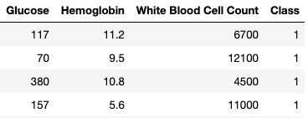
Standardize if Necessary
Chronic Kidney Disease data set
If the attributes are on very different numerical scales, distance can be affected
In such a situation, it is a good idea to convert all the
variables to standard units
(Demo)

